Slide 1
Speed of Waves

Slide 2

Waves: A Review
Notes:
Frequency (f): the number of cycles per unit time
Period (T): the time it takes for one cycle
Video: super Mario physics (Waves)

Slide 3

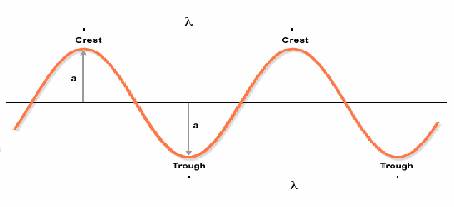
The Wave Equation
You may recall:
Notes:
A general wave will travel 1 wavelength in 1 period and so
v=λ/T or v=λf
This formula works for all waves: visible, invisible, audible, inaudible

Slide 4
The Wave Equation
This equation applies to ALL WAVES
Where:
v is wave speed (m/s)
f is frequency (Hz)
λ is wavelength (m)
Notes:
A general wave will travel 1 wavelength in 1 period and so
v=λ/T or v=λf
This formula works for all waves: visible, invisible, audible, inaudible

Slide 5
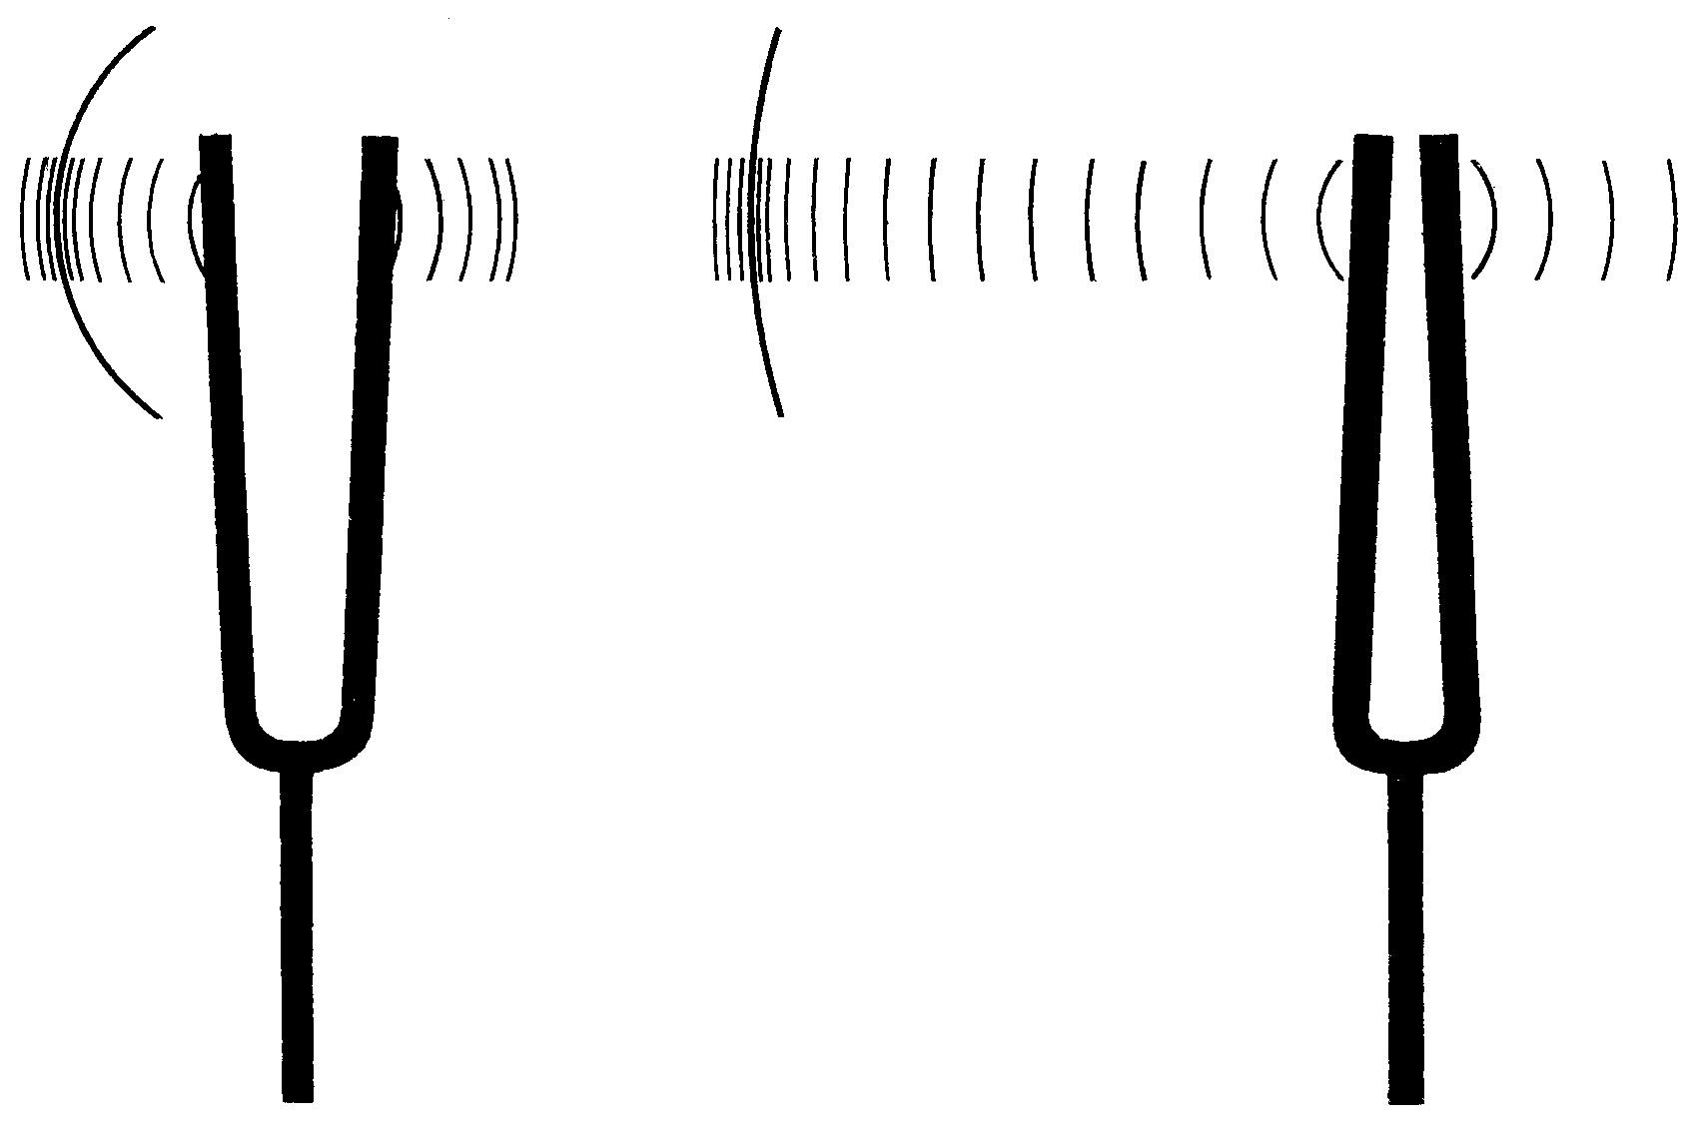
Example
A tuning fork’s tines vibrate back and forth 375 times in 3.00 s. If the wavelength of one cycle is 275 cm, calculate the speed of the sound wave.

Slide 6
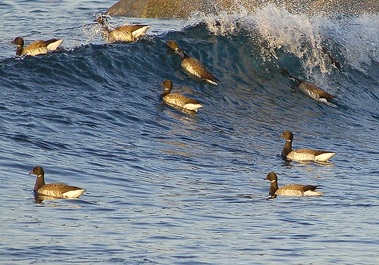
Example
The distance between successive crests in a series of water waves is 4.0 m, and the crests travel 9.0 m in 4.5 s. What is the frequency of the wave?
Notes:
F = 0.50 Hz

Slide 7
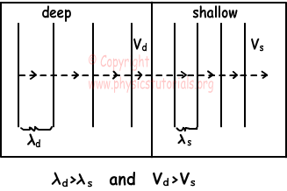
Factors that Affect a Wave’s Speed
A. Type of Material
The energy transfer is more efficient if the particle vibrations do not absorb much energy (ie. rigid objects)

Slide 8
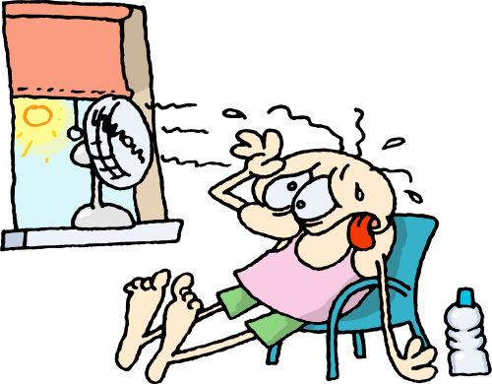
Factors that Affect a Wave’s Speed
B. Temperature
Generally, warmer objects transfer energy more effectively because the molecules collide with neighbours more readily
For example, the speed of sound in air:

Slide 9
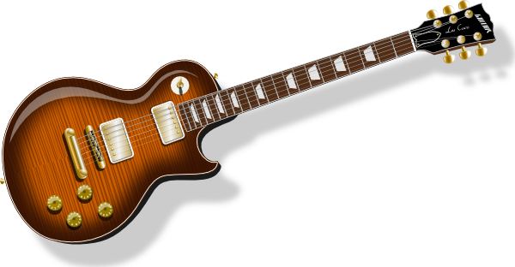
Factors that Affect a Wave’s Speed
C. Other Material Properties
i. Density ( )
Generally, more dense solid materials require more force to cause motion. As a result, they transmit energy less efficiently.
ii. Tension in Strings (F_{T})
Generally, more tense strings are more efficient energy transmitters because they are more elastic.

Slide 10
Example
You have a string of mass 350 g and length 2.3 m. You would like to send a wave along this string at a speed of 50.0 m/s. What must the tension of the string be?

